Slide 1
Operating Systems
Chapter 1 Computer System Overview

Slide 2
Agenda
1.0 Intro
1.1 Basic Elements
1.2 Processor Registers
1.3 Instruction Execution
1.4 Interrupts
1.5 The Memory Hierarchy
1.6 Cache Memory
1.7 I/O Communication Techniques

Slide 3
Agenda
1.0 Intro
1.1 Basic Elements
1.2 Processor Registers
1.3 Instruction Execution
1.4 Interrupts
1.5 The Memory Hierarchy
1.6 Cache Memory
1.7 I/O Communication Techniques

Slide 4
1.0 Intro
Operating System 概述
  承上：Provides a set of services to system users
  启下：Exploits the hardware resources of
    One or more processors
    Main memory
    Manages I/O devices
      secondary memory
      Network Card
      …

Slide 5
Agenda
1.0 Intro
1.1 Basic Elements
1.2 Processor Registers
1.3 Instruction Execution
1.4 Interrupts
1.5 The Memory Hierarchy
1.6 Cache Memory
1.7 I/O Communication Techniques

Slide 6
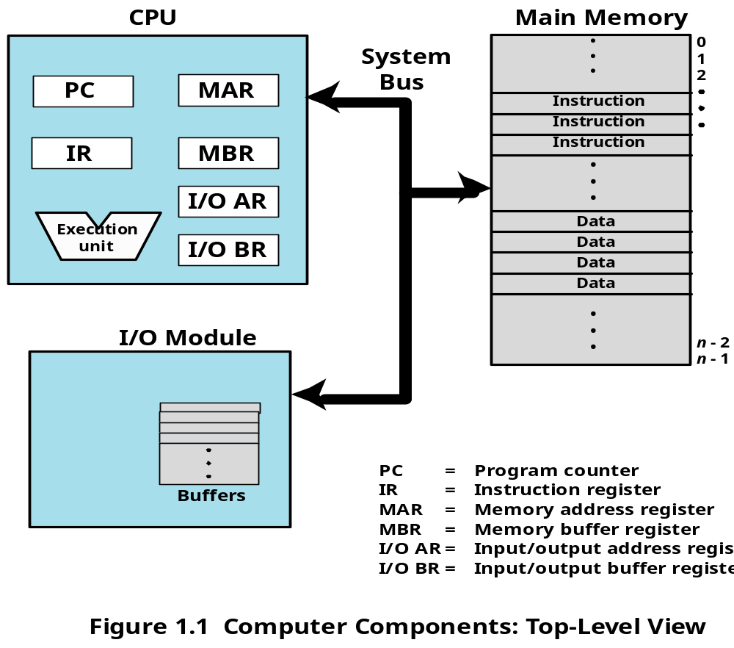
1.1 Basic Elements (1/2)

Slide 7
1.1 Basic Elements (2/2)
Processor(处理器)
Main Memory(内存)
  Volatile （易失性）
  referred to as real memory(实存) or primary memory（主存）
I/O modules(输入/输出模块)
  secondary memory devices （disk）
  communications equipment
  terminals
System bus(系统总线)
  communication among processors, memory, and I/O modules

Slide 8
Agenda
1.0 Intro
1.1 Basic Elements
1.2 Processor Registers
1.3 Instruction Execution
1.4 Interrupts
1.5 The Memory Hierarchy
1.6 Cache Memory
1.7 I/O Communication Techniques

Slide 9
1.2 Processor Registers
Introduction
  What is Registers
    Memory inside CPU
  Why Registers
    Enable CPU to minimize main-memory references
  Can be classified into:
    User-visible registers(用户可见寄存器)
    Control and status registers(控制和状态寄存器)

Slide 10
User-Visible Registers
How to use：May be referenced（访问/存取） by machine/assemble language
Who will use：Available to all programs
  application programs
  system programs

Slide 11
Control and Status Registers (1/2)
Function：are used to control the operation of the processor
Most are not visible to the user.
Some may be accessibly by machine instruction in control or system mode

Slide 12
1.2.2 Control and Status Registers (2/2)
Program Counter (PC)
  Contains the address of an instruction to be fetched
Instruction Register (IR)
  Contains the instruction most recently fetched
Program Status Word (PSW)
  Condition codes [more detail next]
  Other state-related bits, such as:
    Interrupt enable/disable
    Supervisor/user mode
    … …
Notes:
所有的处理器设计还包括一个或一组寄存器，通常称为程序状态字(Program Status Word,PSW )，它包含状态信息。PSW通常包含条件码和其他状态信息，如中断允许/禁止位和内核/用户态位。 条件码( condition code，也称为标记)是处理器硬件为操作结果设置的位。例如，算术运算可能产生正数、负数、零或溢出的结果，除了结果自身存储在一个寄存器或存储器中之外，在算术指令执行之后，也随之设置一个条件码。这个条件码之后可作为条件分支运算的一部分被测试。条件码位被收集到一个或多个寄存器中，通常它们构成了控制寄存器的一部分。机器指令通常允
许通过隐式访问来读取这些位，但不能通过显式访问进行修改，这是因为它们是为指令执行结果的反馈而设计的。

Slide 13
Agenda
1.0 Intro
1.1 Basic Elements
1.2 Processor Registers
1.3 Instruction Execution
1.4 Interrupts
1.5 The Memory Hierarchy
1.6 Cache Memory
1.7 I/O Communication Techniques

Slide 14
1.3 Instruction Execution (1/7)
Program in memory
Instruction 1
Instruction n
Program 1
PC
data 1
IR
data n
R
CPU
M

Slide 15
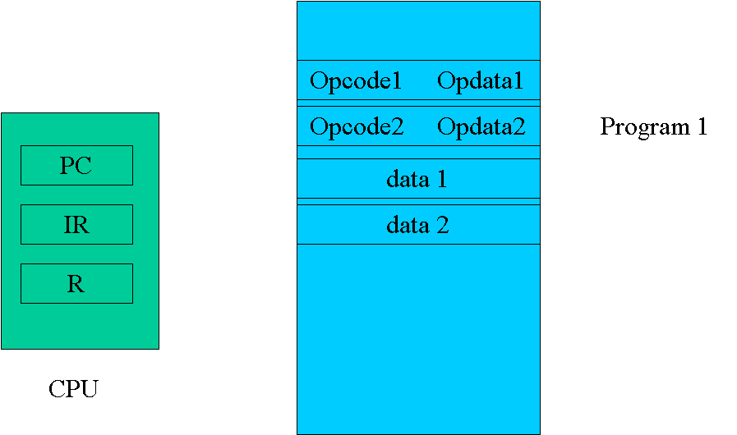
1.3 Instruction Execution (2/7)
Key point:
  Program counter (PC) of CPU holds address of the instruction to be fetched next
  Fetched instruction is placed in the instruction register (IR)
  Program counter (PC) of CPU is incremented after each fetch

Slide 16
1.3 Instruction Execution (3/7)
Instruction Cycle(指令周期)
  The processing required for a single instruction execution

Slide 17
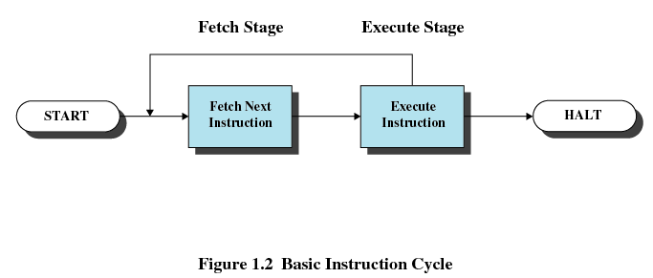
1.3 Instruction Execution (4/7)
Two stages of each Instruction Execution
  Processor reads/loads/Fetches instructions from memory
  Processor Executes each instruction

Slide 18
1.3 Instruction Execution (5/7)
An Example (cont.): the CPU
PC
IR
AC
CPU

Slide 19
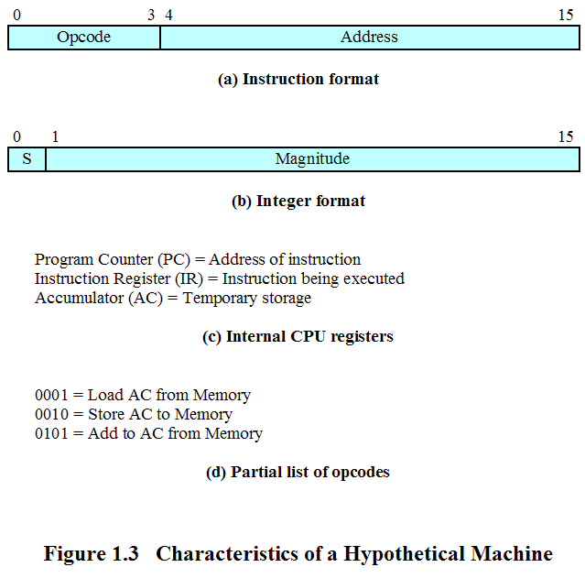
1.3 Instruction Execution (6/7)
An Example: the Instruction
一台理想机器的特征
Notes:
累加寄存器（AC）通常简称为累加器，它是一个通用寄存器。
oool=从存储器中加载AC 2
0010=把AC的内容存储到存储器中 2
0101=从存储器中加到AC中 5

Slide 20
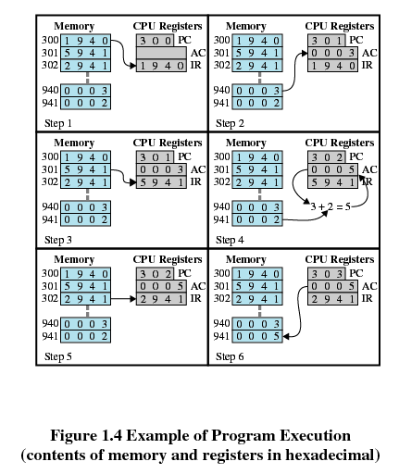
1.3 Instruction Execution (11/12)
An Example (cont.): the process of a program execution
指令1
指令2
指令3

Slide 21
Agenda
1.0 Intro
1.1 Basic Elements
1.2 Processor Registers
1.3 Instruction Execution
1.4 Interrupts
1.5 The Memory Hierarchy
1.6 Cache Memory
1.7 I/O Communication Techniques

Slide 22
1.4 Interrupts
1.4.0 Interrupt Introduction
1.4.1 Interrupts and the Instruction Cycle
1.4.2 Interrupt Processing
1.4.3 Multiple Interrupts
1.4.4 Multiprogramming

Slide 23
1.4.0 Interrupt Introduction (1/2)
Why Interrupt in computer system?
  Most I/O devices are slower than the processor，so interrupt can improve CPU’s utilization（提高CPU利用率）
    Processor must pause to wait for device
    E.g.: printer disk
  Count （计数时钟中断）
  Avoid some program to monopolize CPU (避免CPU被独占)
Notes:
时钟中断
（计数）

Slide 24
1.4.0 Interrupt Introduction (2/2)
Introduction Interrupt Definition
  A mechanism by which other modules (I/O, clock) may interrupt the normal sequencing of the processor.
    An I/O device can stop what the CPU is operating to provide some necessary service.
  Interrupt and Restore/Resume
    Both software and hardware are used to support it
Notes:
Mechanism 机制

Slide 25
1.4 Interrupts
1.4.0 Interrupt Introduction
1.4.1 Interrupts and the Instruction Cycle
1.4.2 Interrupt Processing
1.4.3 Multiple Interrupts
1.4.4 Multiprogramming

Slide 26
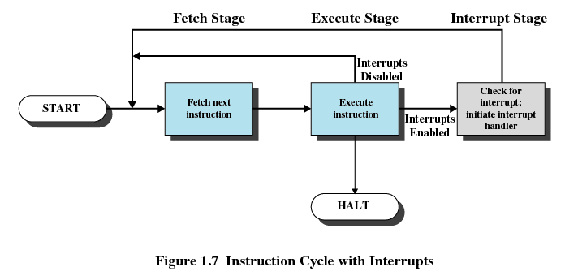
1.4.1 Interrupts and the Instruction Cycle(1/2)
Instruction Cycle With Interrupts

Slide 27
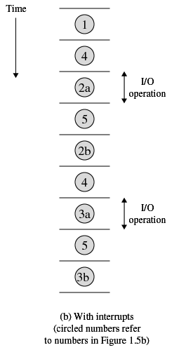
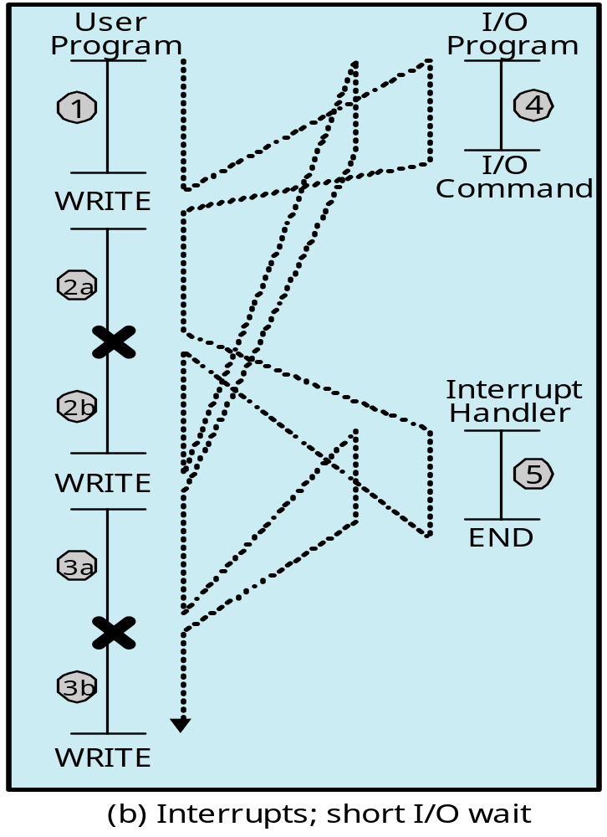
1.4.1 Interrupts and the Instruction Cycle(2/2)
中断点
中断点

Slide 28
1.4 Interrupts
1.4.0 Interrupt Introduction
1.4.1 Interrupts and the Instruction Cycle
1.4.2 Interrupt Processing
1.4.3 Multiple Interrupts
1.4.4 Multiprogramming

Slide 29
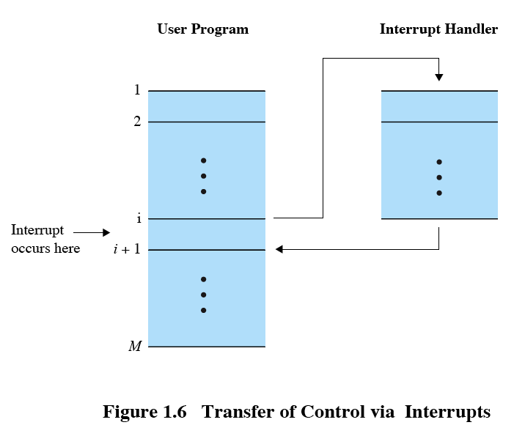
1.4.2 Interrupt Processing (1/5)
Suspends the normal sequence of execution

Slide 30
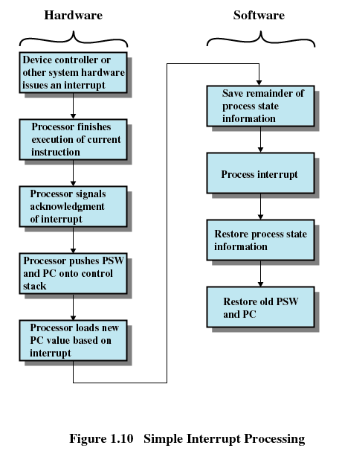
1.4.2 Interrupt Processing (2/5)

Slide 31
1.4.2 Interrupt Processing (3/5)

Slide 32
1.4.2 Interrupt Processing (4/5)
修改PC的值成中断服务程序首指令的地址

Slide 33
1.4.2 Interrupt Processing (5/5)

Slide 34
1.4 Interrupts
1.4.0 Interrupt Introduction
1.4.1 Interrupts and the Instruction Cycle
1.4.2 Interrupt Processing
1.4.3 Multiple Interrupts
1.4.4 Multiprogramming

Slide 35
1.4.3 Multiple Interrupts (1/4)
Q: What will happen if an I/O modules rouse a Interrupt, while the CPU is processing instruction of an ISR
  That is interrupt an ISR
Notes:
ISR终端服务例程 rouse 叫醒 Service Routine

Slide 36
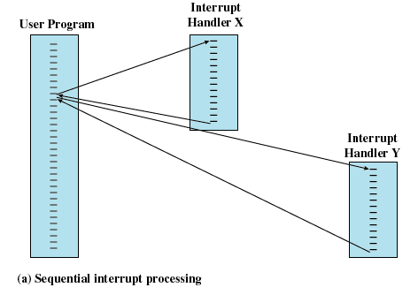
1.4.3 Multiple Interrupts (2/4)
Method 1：Disable interrupts while an interrupt is being processed

Slide 37
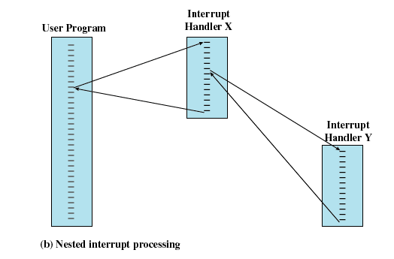
1.4.3 Multiple Interrupts (3/4)
Method 2： Define priorities for interrupts

Slide 38
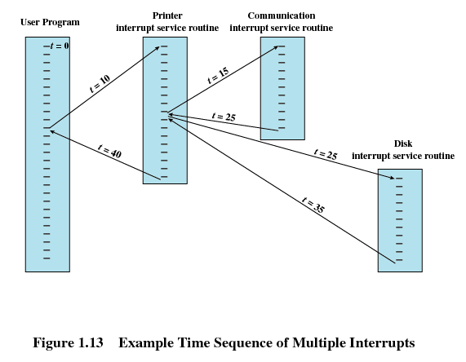
1.4.3 Multiple Interrupts (4/4)
An Example of Method 2

Slide 39
1.4 Interrupts
1.4.0 Interrupt Introduction
1.4.1 Interrupts and the Instruction Cycle
1.4.3 Interrupt Processing
1.4.3 Multiple Interrupts
1.4.4 Multiprogramming

Slide 40
1.4.4 Multiprogramming
Multiprogramming(多道程序)
  If the time required to complete an I/O operation is much greater than the user code between I/O calls, then the processor will be idle much of the time
  A solution to this problem is to allow multiple user programs to be active at the same time

Slide 41
Agenda
1.0 Intro
1.1 Basic Elements
1.2 Processor Registers
1.3 Instruction Execution
1.4 Interrupts
1.5 The Memory Hierarchy
1.6 Cache Memory
1.7 I/O Communication Techniques

Slide 42
1.5 The Memory Hierarchy (1/5)
The design constraints of a computer’s memory
  How much : Capacity : larger
  How fast : Speed : faster/ as fast as CPU
  How expensive : Price : cheaper
CPU
M
Disk

Slide 43
1.5 The Memory Hierarchy (2/5)
(Speed , Price, Capacity)的不可兼得性/矛盾:
  Faster access time, greater cost per bit
  Greater capacity, smaller cost per bit
  Greater capacity, slower access speed
What can we do?
  中庸？
    To use them all in the right way: Memory Hierarchy

Slide 44
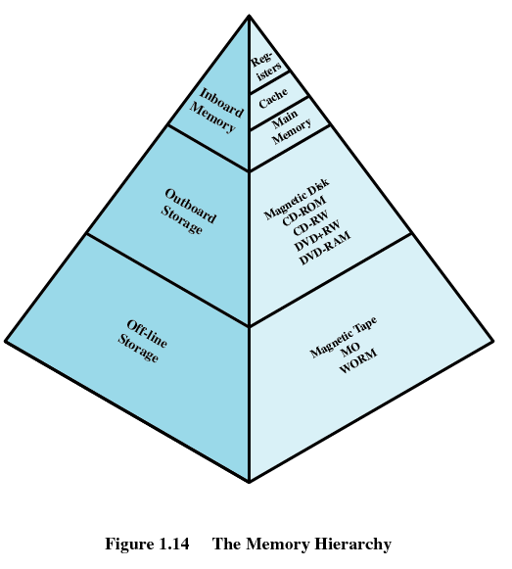
1.5 The Memory Hierarchy (3/5)
Memory Hierarchy： Three Levels
  Level 1：板上存储器
  Level 2：板外存储器
  Level 3：离线存储器

Slide 45
1.5 The Memory Hierarchy (4/5)
Going Down the Hierarchy
  Increasing capacity
  Increasing access time ( that is slow speed )
  Decreasing cost per bit
  Decreasing frequency of access of the memory by the processor

Slide 46
1.5 The Memory Hierarchy (5/5)
Obtaining larger and faster memory
  Get larger capacity
    Smaller, more expensive, faster memories are supplemented (后备) by larger, cheaper, slower memories
  Get faster speed
    larger, cheaper, slower memories are cached（缓存） by Smaller, more expensive, faster memories
Locality of reference(访问局部性/局部性原理/principle of locality)
  Spatial locality (空间局部性)
  Temporal locality (时间局部性)
  Why it exists
Notes:
Principle of locality – high probability that a referenced word and data in the vicinity of the referenced word are likely to be referenced in the near future

Slide 47
Agenda
1.0 Intro
1.1 Basic Elements
1.2 Processor Registers
1.3 Instruction Execution
1.4 Interrupts
1.5 The Memory Hierarchy
1.6 Cache Memory
1.7 I/O Communication Techniques

Slide 48
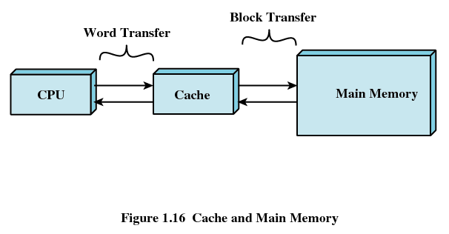
1.6 Cache Memory (1/4)
Exploit the principle of locality
  Add something cache between fast and slow memory

Slide 49
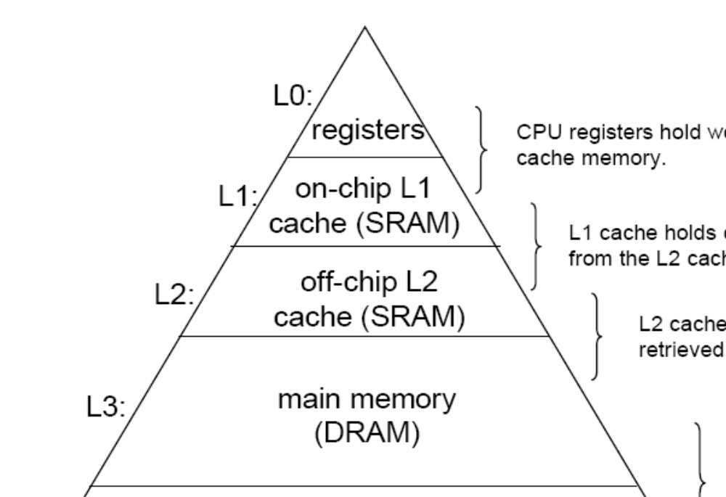
1.6 Cache Memory (2/4)

Slide 50
1.6 Cache Memory (3/4)
Cache Principles
  Contains a copy of a portion of main memory
  Processor first checks cache
    (Hit) If found, just use it. And do not need access to the memory
    (Miss) If not found in cache, the block of memory containing the needed information is moved to the cache and delivered to the processor
Notes:
portion 一份

Slide 51
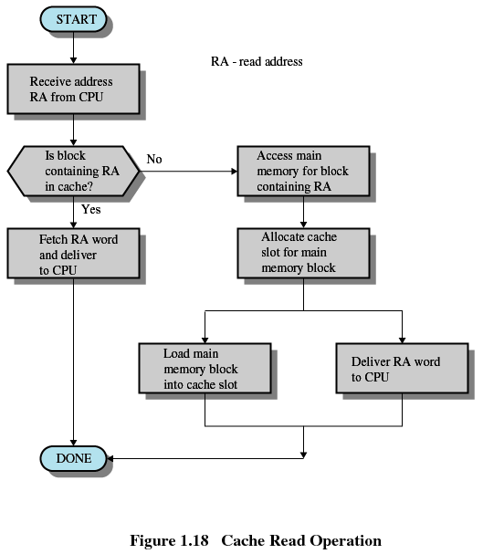
1.6 Cache Memory (4/4)

Slide 52
Agenda
1.0 Intro
1.1 Basic Elements
1.2 Processor Registers
1.3 Instruction Execution
1.4 Interrupts
1.5 The Memory Hierarchy
1.6 Cache Memory
1.7 I/O Communication Techniques

Slide 53
1.7 I/O Communication Techniques (1/4)
Three methods
  Programmed I/O
  Interrupt-Driven I/O
  Direct Memory Access / DMA
CPU
M
I/O
I/O

Slide 54
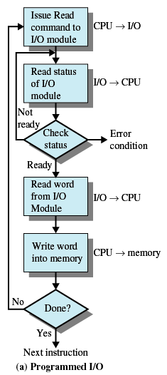
1.7 I/O Communication Techniques (2/4)
Method1: Programmed I/O (可编程I/O)
  I/O module performs the action, not the processor
  I/O module sets appropriate bits in the I/O status register
  Processor checks status until operation is complete
  Disadvantage: It is a time-consuming process that keeps the processor busy needlessly.

Slide 55
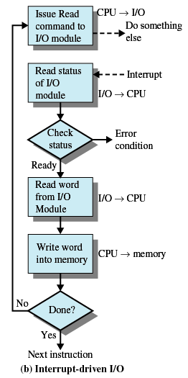
1.7 I/O Communication Techniques (3/4)
Method2: Interrupt-Driven I/O
  Processor is interrupted when I/O module ready to exchange data
  Processor saves context of program executing and begins executing interrupt-handler
  Advantage：No needless waiting, so more efficient than programmed I/O
  Disadvantage ：Still consumes a lot of processor time because every word read or written passes through the processor

Slide 56
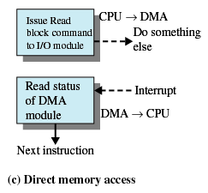
1.7 I/O Communication Techniques (4/4)
Method3: Direct Memory Access
  Transfers a block of data directly to or from memory，I/O exchanges occur directly with memory
    Processor grants I/O module authority to read from or write to memory
    Processor continues with other work
    An interrupt is sent when the transfer is complete
  Advantage：Relieves the processor responsibility for the exchange

